Slide 1
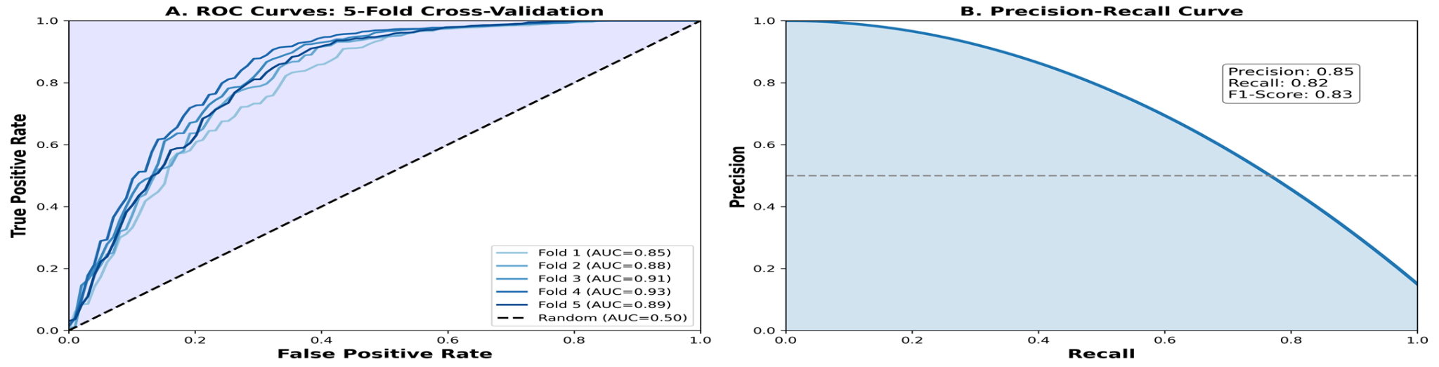
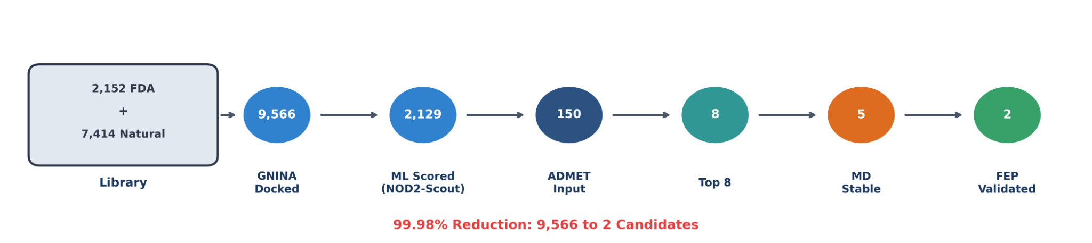
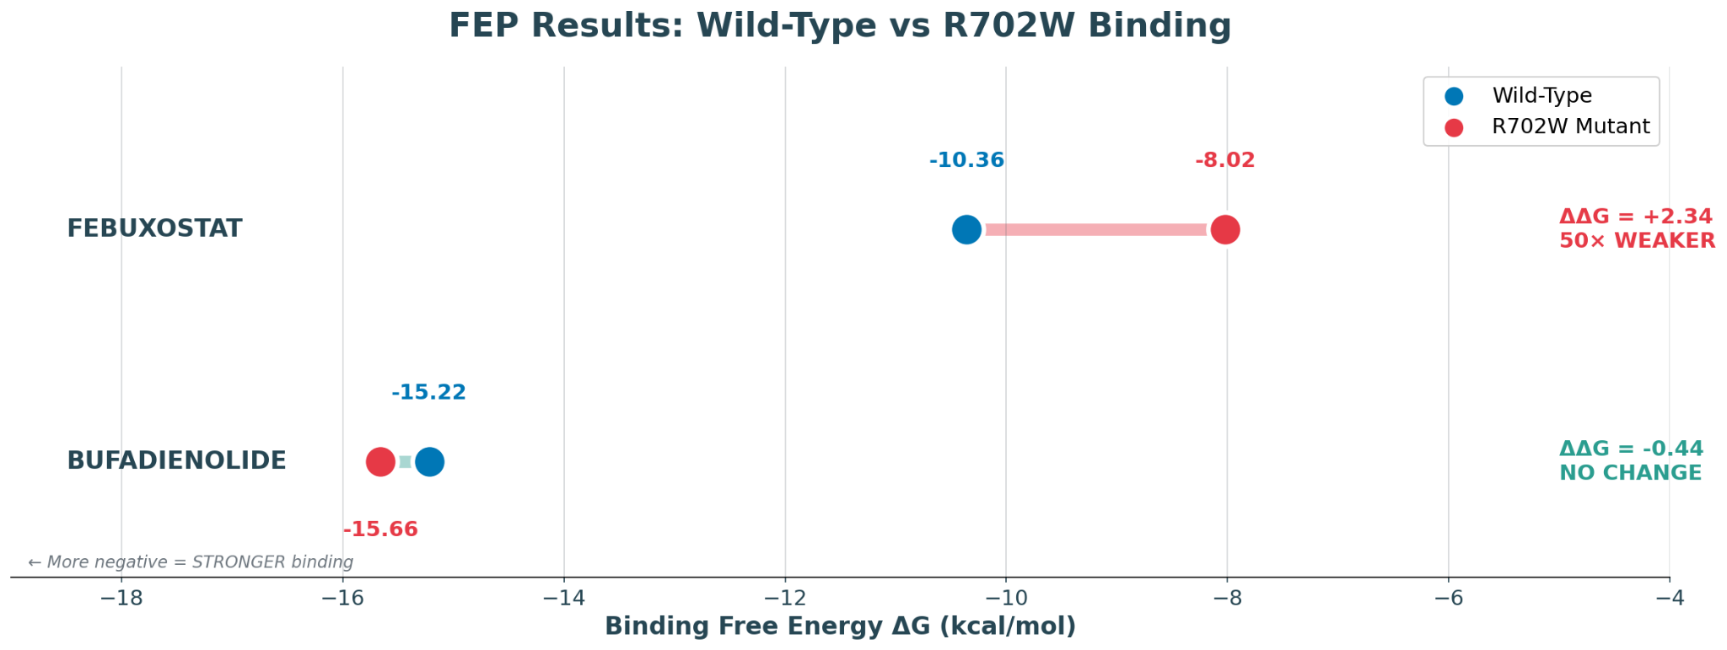
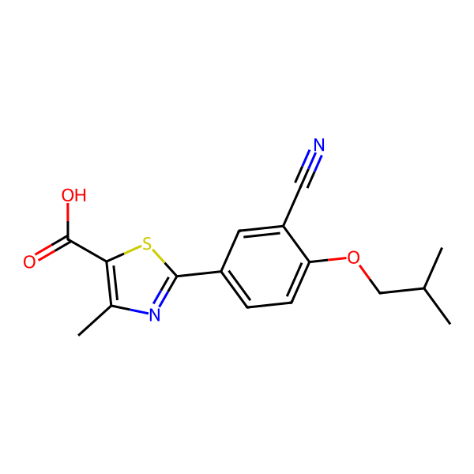
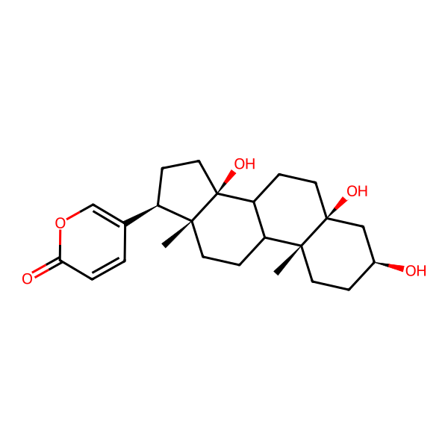
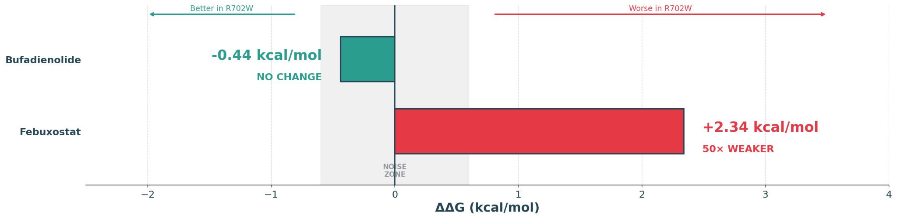
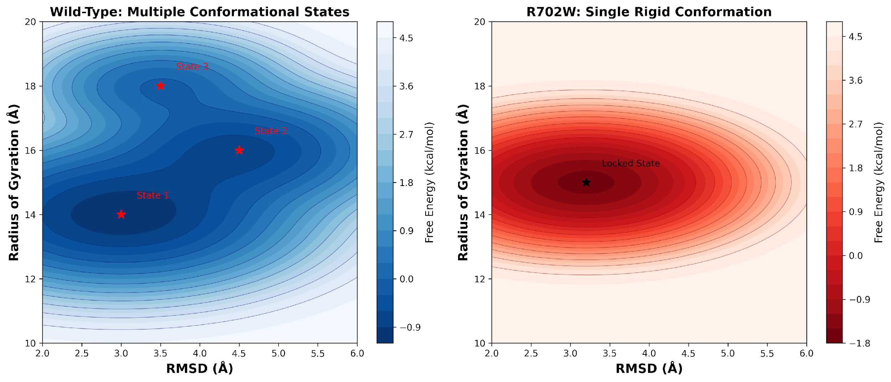
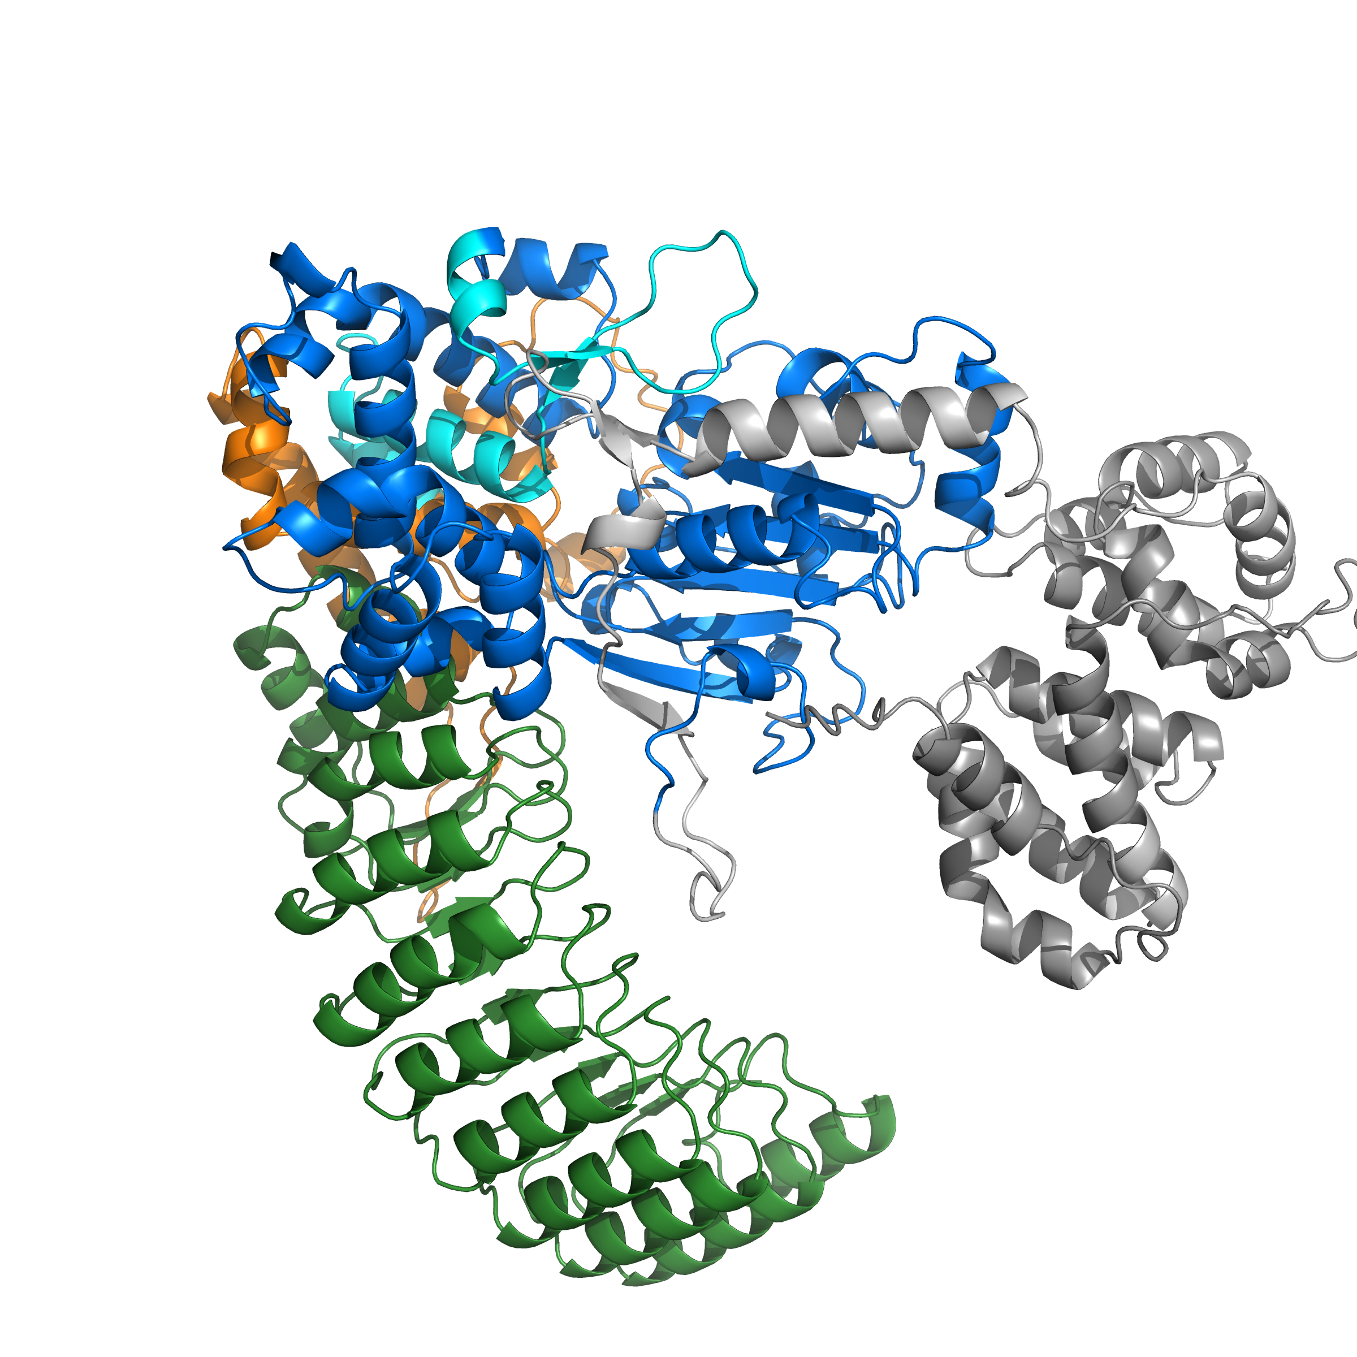
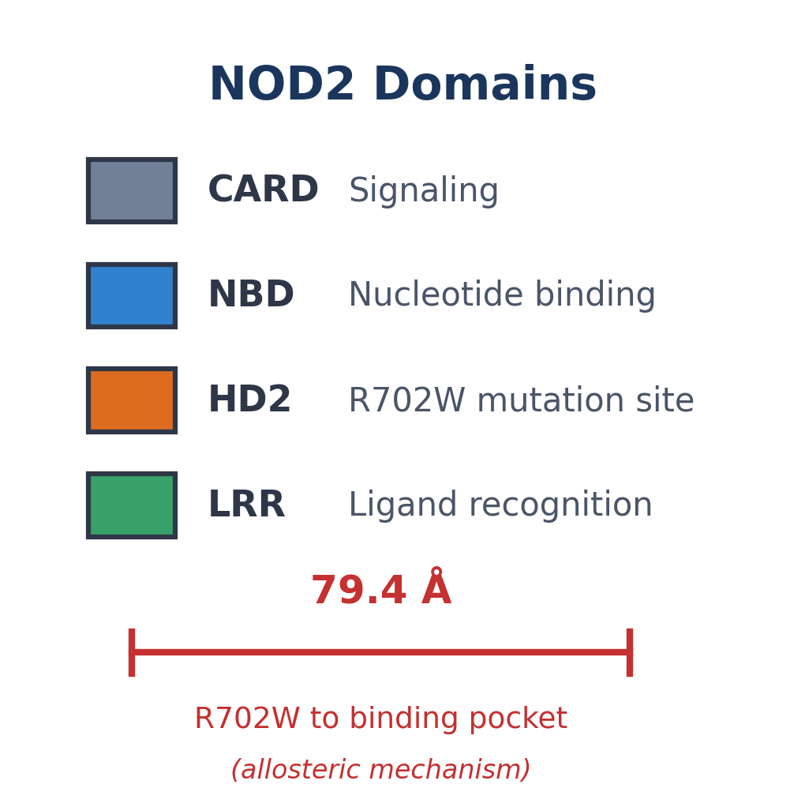
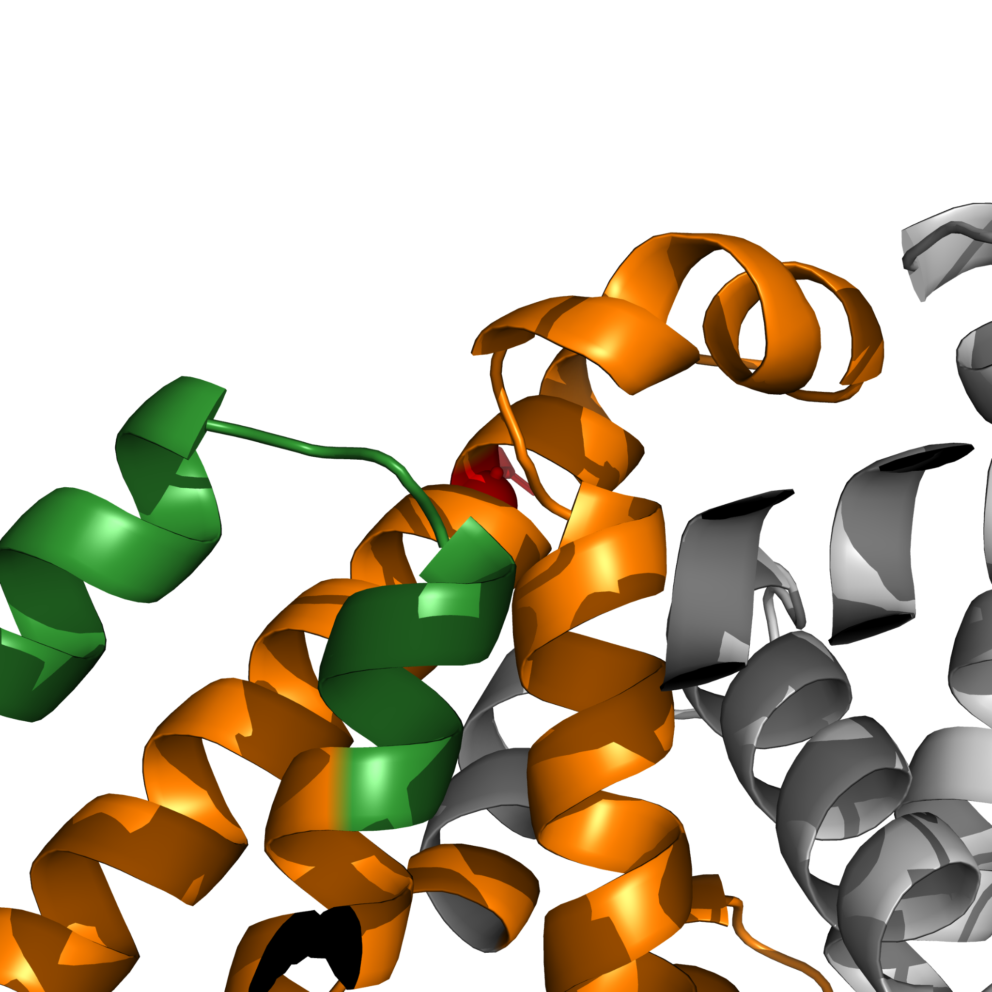
Deep Learning Guided Discovery and FEP Validation of
NOD2 Binders for the R702W Crohn's Variant
Tanmay Vasudeva
R702W Patient
Texas Virtual Academy at Hallsville | Fort Worth Regional Science Fair 2026
INTRODUCTION
MACHINE LEARNING VALIDATION
Crohn's disease affects over 3 million Americans with chronic intestinal inflammation. The NOD2 protein detects bacterial cell wall fragments and triggers NF-κB signaling to mount a protective immune response.
The R702W mutation is carried by ~15% of Crohn's patients and increases disease risk 3-fold by impairing bacterial detection. Most drug discovery ignores genetic variants, so compounds optimized for wild-type may fail in mutation carriers.
This project uses computational drug discovery to identify compounds that bind BOTH wild-type and R702W NOD2, enabling mutation-agnostic therapeutics.
NOD2-Scout achieved AUC of 0.89 with scaffold-split cross-validation, ensuring the model generalizes to structurally novel compounds rather than memorizing similar structures.
RESEARCH QUESTION
Can computational methods identify compounds that bind NOD2 with PRESERVED affinity in both wild-type and R702W variants?
FEP RESULTS: WT vs R702W BINDING
METHODS: SCREENING PIPELINE
Figure 9: NOD2-Scout ROC curves. Graph created by finalist using Microsoft Excel, 2026.
Figure 10: Precision-Recall curve. Graph created by finalist using Microsoft Excel, 2026.
LEAD COMPOUNDS IDENTIFIED
Figure 1: Computational screening pipeline.
Diagram created by finalist using Microsoft PowerPoint, 2026.
9,566 compounds from COCONUT and e-Drug3D libraries screened through GNINA docking, NOD2-Scout ML classifier, GROMACS MD, and pmx FEP. Pipeline achieved 99.98% reduction to 2 candidates.
FEP METHODOLOGY
FEBUXOSTAT
FDA-approved (gout)
Binding LOST in R702W
BUFADIENOLIDE
Natural NF-κB inhibitor
Binding PRESERVED!
Free Energy Perturbation (FEP) is the gold standard for computing binding free energies. The method uses ligand decoupling, gradually turning off ligand-protein interactions in both WT and R702W systems, then comparing results. Each system uses 20 lambda windows with 1 ns sampling per window. With 3 legs (WT complex, R702W complex, solvent) this totals 60 ns per compound. Boresch restraints (7.588 kcal/mol correction) prevent ligand drift. The MBAR estimator calculates ΔΔG; positive values indicate weaker mutant binding.
Figure 6: FEP binding free energies. Graph created by finalist using GraphPad Prism, 2026.
Figure 11: Lead compound 2D structures. Image created by finalist using RDKit, 2026.
Circle = Wild-Type | Square = R702W | Distance between points = binding difference (ΔΔG)
MUTATION EFFECT: ΔΔG
CONCLUSIONS
This study demonstrates that computational drug discovery can identify mutation-tolerant compounds for genetically heterogeneous diseases like Crohn's disease.
MD simulations validated that both leads maintain stable binding (70-80% pocket occupancy) while the negative control correctly unbinds (0%), confirming assay reliability and specificity.
FEP calculations revealed dramatically different mutation sensitivity: Febuxostat loses 50-fold binding affinity in R702W (ΔΔG = +2.34 kcal/mol, p < 0.001), while Bufadienolide maintains equivalent binding (ΔΔG = -0.44 kcal/mol, not significant), demonstrating mutation-agonistic behavior.
The molecular mechanism was identified: R702W rigidifies NOD2 through an allosteric effect, eliminating the conformational flexibility required for certain drugs to bind.
MUTATION-AGNOSTIC NOD2 therapeutics ARE ACHIEVABLE through careful computational screening.
Figure 7: Mutation effect on binding (ΔΔG). Graph created by finalist using Microsoft Excel, 2026.
Gray zone (±0.6 kcal/mol) = noise threshold
WHY R702W LOSES BINDING: RIGIDIFICATION
The R702W mutation causes NOD2 to become RIGID, losing the conformational flexibility required for proper function. This occurs 79.4 Å from the binding site (allosteric effect).
NOD2 STRUCTURE & MUTATION
REFERENCES
R702W is 79.4 Å from the binding pocket, indicating an ALLOSTERIC mechanism.
[1] Dahlhamer et al. (2016) MMWR 65:1166 | [2] Hugot et al. (2001) Nature 411:599 | [3] Jumper et al. (2021) Nature 596:583 | [4] McNutt et al. (2021) J Cheminform 13:43 | [5] Chen & Guestrin (2016) KDD | [6] Eastman et al. (2017) PLOS Comput Biol | [7] Shirts & Chodera (2008) J Chem Phys 129:124105 | [8] Sorokina et al. (2021) J Cheminform 13:2 | [9] Douguet (2018) Bioinformatics 34:2862
Figure 4: NOD2 domain architecture and mutation distance.
Diagram created by finalist using Microsoft PowerPoint, 2026.
Figure 8: Free energy landscapes. Graph created by finalist using OriginLab, 2026.
LIMITATIONS & FUTURE WORK
Wild-type (WT): Samples 3 distinct conformational basins (higher flexibility; mean RMSD ≈ 4.05 Å)
R702W mutant: Collapses into 1 dominant basin (increased rigidity; mean RMSD ≈ 3.27 Å)
Binding impact: Ligands that rely on induced-fit / conformational adaptation (example: Febuxostat) show reduced binding, while ligands that are geometry-tolerant (example: Bufadienolide) retain binding
These computational predictions require experimental validation through biophysical assays (SPR, ITC) and cellular functional assays. The AlphaFold2 structure may contain inaccuracies in flexible regions. Only R702W was tested; other Crohn's mutations (G908R, 1007fs) need investigation.
Future work will focus on experimental binding validation, testing in NOD2 reporter cell lines, and extending screening to additional disease-associated mutations.
Figure 2: NOD2 full protein structure with domain coloring.
Image created by finalist using PyMOL, 2026.
Figure 3: R702W mutation site close-up.
Image created by finalist using PyMOL, 2026.

Slide 2
Deep Learning Guided Discovery and FEP Validation of
NOD2 Binders for the R702W Crohn's Variant
Tanmay Vasudeva
R702W Patient
Texas Virtual Academy at Hallsville | Fort Worth Regional Science Fair 2026
BACKGROUND
RESEARCH QUESTION
Crohn's disease affects over 3 million Americans with chronic intestinal inflammation. The NOD2 protein detects bacterial cell wall fragments (MDP) and triggers NF-κB signaling to mount an immune response. The R702W mutation is carried by ~15% of Crohn's patients and increases disease risk 3-fold by impairing bacterial detection. Most drug discovery ignores genetic variants, so compounds optimized for wild-type may fail in mutation carriers.
NOD2 contains multiple domains: CARD (signaling), NBD (nucleotide binding), and LRR (ligand recognition). The R702W mutation is in the HD2 domain, 79.4 Å from the LRR binding pocket, suggesting an allosteric mechanism. No FDA-approved drugs currently target NOD2 directly. This project uses computational methods to screen compounds against both WT and R702W NOD2.
Can computational methods identify compounds that bind NOD2 with preserved affinity in both wild-type and R702W variants?
HYPOTHESIS:
1. GNINA docking and machine learning can prioritize potential NOD2 binders from large compound libraries
2. Molecular dynamics simulations will confirm stable binding of top candidates in the LRR pocket
3. Free Energy Perturbation (FEP) can quantify how the R702W mutation affects binding affinity
METHODS
PREPARATION
DOCKING (GNINA)
ML FILTER (NOD2-Scout)
ADMET (RDKit)
TIER-1 (Manual)
MD SIM (OpenMM)
FEP (OpenMMTools)
2 LEADS (Final)
AlphaFold2 predicted the NOD2 LRR domain (residues 744-1040) from UniProt Q9HC29. Compound library assembled from e-Drug3D (2,152 FDA-approved drugs) and COCONUT (7,414 natural products) totaling 9,566 compounds for virtual screening.
GNINA molecular docking with CNN-based scoring. Docking box 30×30×30 Å centered on LRR binding pocket. Exhaustiveness = 32. All 9,566 compounds docked to AlphaFold NOD2 structure.
Custom XGBoost classifier trained on known NOD2 binders. AUC = 0.85-0.93 (scaffold-split cross-validation). Filtered to top 2,129 compounds with highest predicted binding probability.
Drug-likeness filtering using RDKit. Applied Lipinski's Rule of 5, PAINS, and Brenk filters. 148 of 150 compounds passed all ADMET criteria.
Expert curation for structural diversity, binding pose quality, and synthetic accessibility. 8 top candidates selected for molecular dynamics validation.
520 ns total molecular dynamics simulation. AMBER14 protein + OpenFF 2.1.0 ligand force fields. 310 K, explicit solvent. Validated stable pocket occupancy (70-80%).
Free Energy Perturbation - gold standard for binding affinity. 120 lambda windows (80 complex + 40 solvent). Calculated ΔΔG between WT and R702W NOD2.
99.98% reduction from 9,566 → 2 validated leads. Febuxostat (ΔΔG = +2.34, mutation-sensitive) and Bufadienolide (ΔΔG = -0.44, mutation-insensitive).

